Slide 1
Voice of the Customer (VOC) Sentiment Classification Using Text Analytics and Machine Learning
Success Through Hyper Awareness of the Customer
John Aaron
September 25, 2018

Slide 2
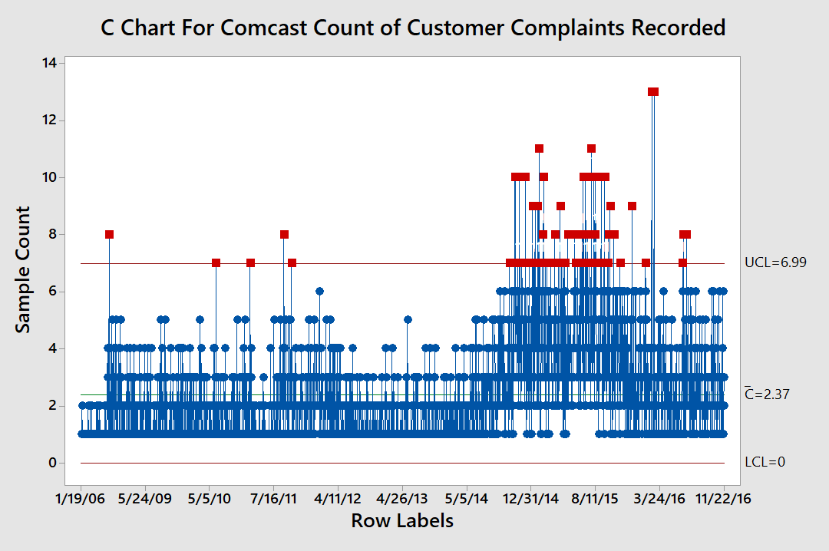

Slide 3
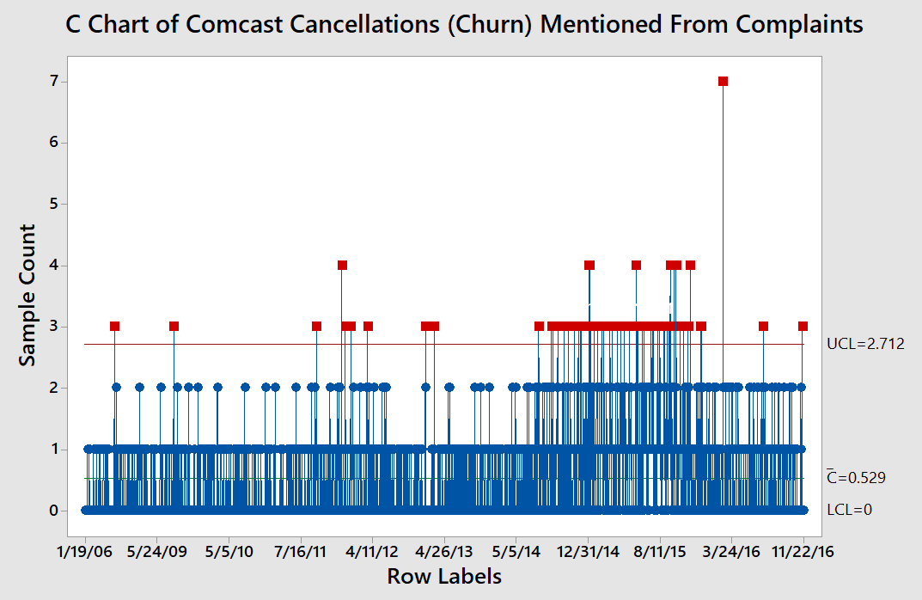

Slide 4
Part 1—Customer Sentiment-The Foundation of Customer Awareness

Slide 5
Purpose, Process and Payoff
Purpose
Businesses pursue various methods to secure real time customer feedback to ensure high levels of customer satisfaction.
Sentiment is most commonly measured on customer surveys using scaled responses (1 to 5 stars) or the Wong-Baker faces (frowning through smiling such as used by doctors to assess pain)
However, most available customer feedback comes not from surveys but from everyday communication and interaction with customers in the form of unstructured text narratives
It is beneficial to leverage this customer intelligence by having a real-time capability that reliably classifies customer feedback narratives as being either positive or negative sentiment.
Having this real time classification in a time series could:
Automatically trigger corrective/preventative actions when specific thresholds are met
Serve as a valuable KPI

Slide 6
Purpose, Process and Payoff
Process
Collected several publicly available datasets of customer product review narratives with associated scaled ratings.√ Done
Ran the narratives through a text analyzer to identify strong predictor key words for positive sentiment and for negative sentiment. √ Done
Exported the Keyword frequencies and associated ratings for analysis in a data modeler tool. √ Done
Created and validated a predictive model that will convert keyword frequencies into a probability of sentiment by classification (positive or negative) √ Done
Designed generic workflow for demonstration. √ Done
Create code for predictive model. √ Regression code Done
Complete remaining code to read text data √(To do: company specific).
Business deploys, tests, train staff. √ (To do: company specific)
Plot as a Time Series. √ (To do: company specific)

Slide 7
Purpose, Process and Payoff
Payoff
A validated sentiment predictor that can be applied to any set of text from customer interactions (such as marketing, sales and customer service) that enables a business to obtain hyper awareness of customer satisfaction and that can trigger timely correction of emerging problems.
Supports an organizations to leverage large quantities of unstructured data that can provide insights to the Voice of the Customer
Provides a foundation for combining both structured and unstructured data.

Slide 8
Workflow Of Machine Learning Sentiment Classifier
The Foundation
Text Resulting from Customer Interactions (e.g. CRM)
Wordstat Text Analytics
Salford Predictive Modeler (SPM)
Sentiment Classifier
Text Extracted From Documents and Records
Wordstat
Sentiment Time Series Plot
CUSUM Changepoint Analysis
Sales Opportunities
Customer Service
Marketing Campaigns
Customer Surveys
Messaging
Social Media
Negative
Sentiment
Downturns in Sentiment
Immediate Preventative and Corrective Actions
Yes
Threshold
Reached?
Building the Classifier
Priority
Case Assignment and Internal Investigation
of the Problem
Engage Customer in
a Timely Manner to
Resolve Issues

Slide 9
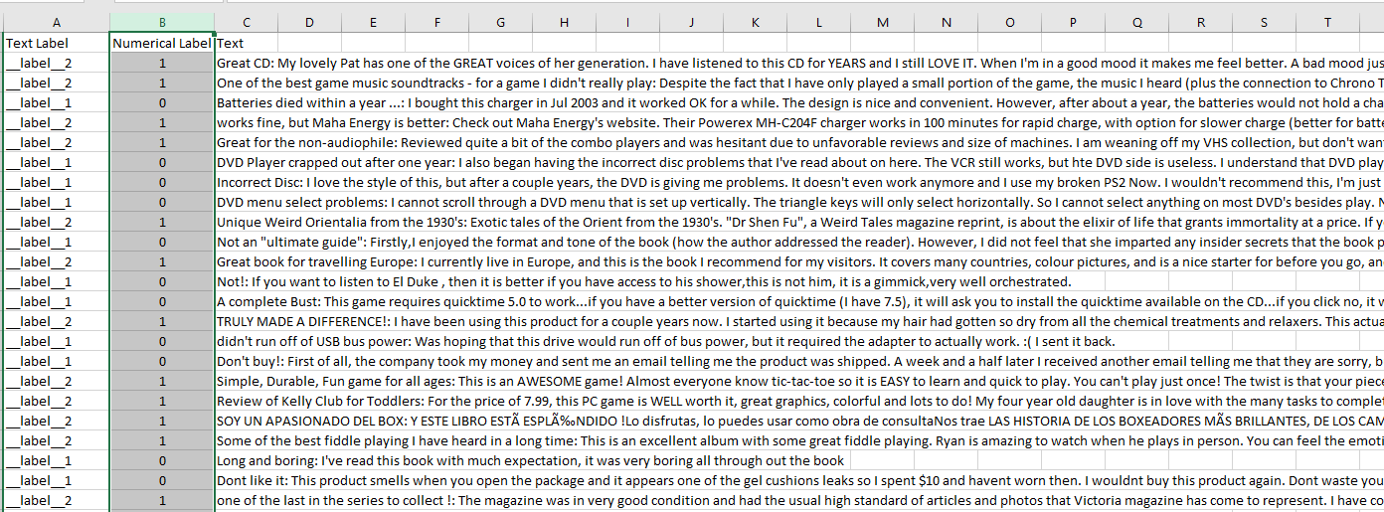
Benchmark Data: Example 400,000 Amazon Customer Reviews
Numeric Labels of Satisfaction and Text Narratives As Inputs to Develop the Model
Customer Narrative/Commentary
Label=Customer Scaled Evaluation Rating of Product

Slide 10
Note: Text Associated with Business Sentiment May Be Industry Specific, Company Specific or Product Specific.
This Presentation Describes a Methodology That Can Be Applied Generally and In Some Cases The Model Can Be Used as a Starting Point.
Provalis Research Provides a Detailed White Paper on This Topic
https://provalisresearch.com/products/content-analysis-software/wordstat-dictionary/sentiment-dictionaries/

Slide 11
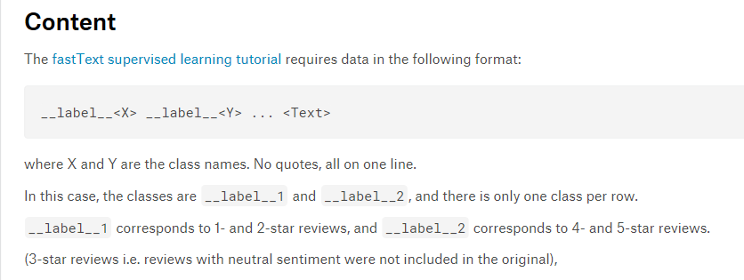
Amazon’s Dataset Contains Text and Scaled Evaluations Of Consumers Across a Variety of Products
Every Organization’s Customer Base Is Unique, Yet the Sample Size and Heterogeneity Suggest That This Classifier Could Be a Good Starting Model for Many Organizations

Slide 12
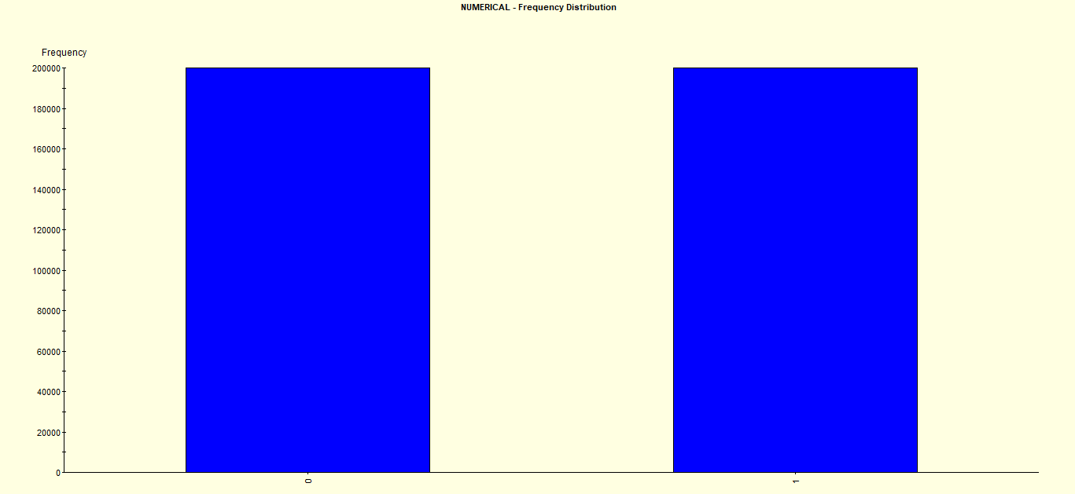
Our Amazon Benchmarking Dataset Is Balanced Containing 200K Records Each
for Both Positively and Negatively Rated Products

Slide 13
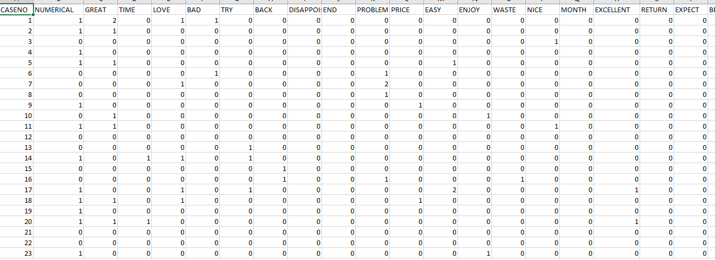
Wordstat Text Analysis Isolates Key Words and Associates Keyword Frequency with Label for Each Record Enables Predictive Modeling of Customer Evaluation
Numeric Label
1=positive
0=negative
Predictors of Evaluation and Frequency of Mention

Slide 14
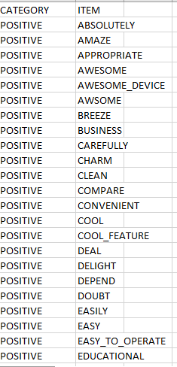
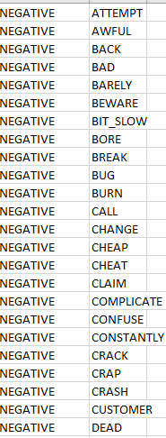
A Total of 410 Words and Phrases Were Identified as Strong Evaluation Predictors Across Multiple Datasets
273 positive words and phrases
137 negative words and phrases

Slide 15
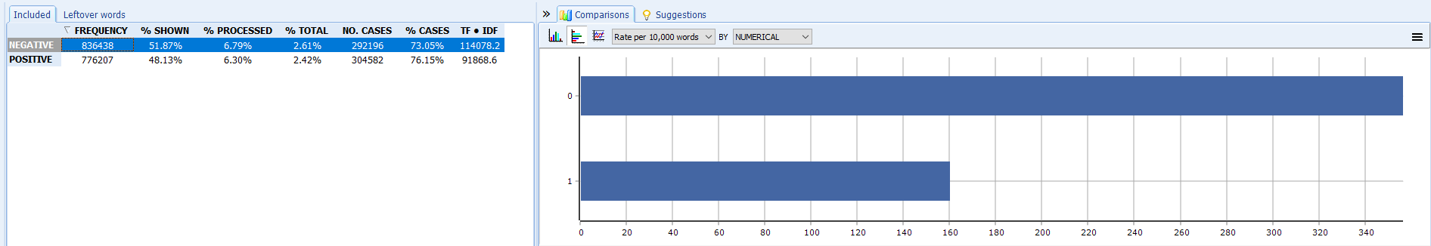
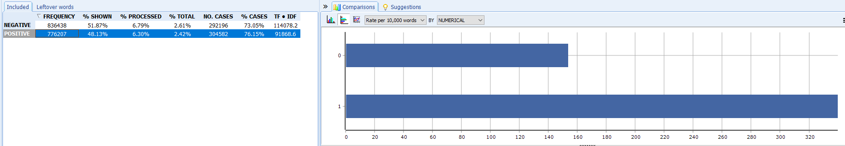
Wordstat: The Evaluation Predictors Show Acceptable Discrimination in the Balanced Dataset Used for Benchmarking and Calibration

Slide 16
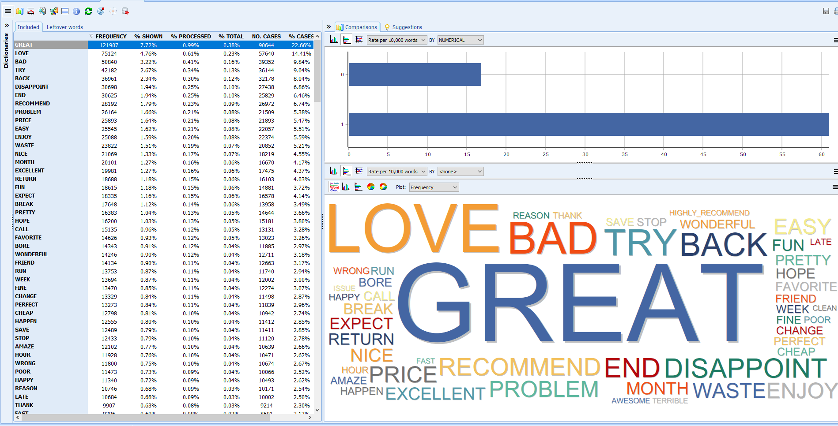
Example: The Word “Great” Shows High Association With a Positive Evaluation

Slide 17
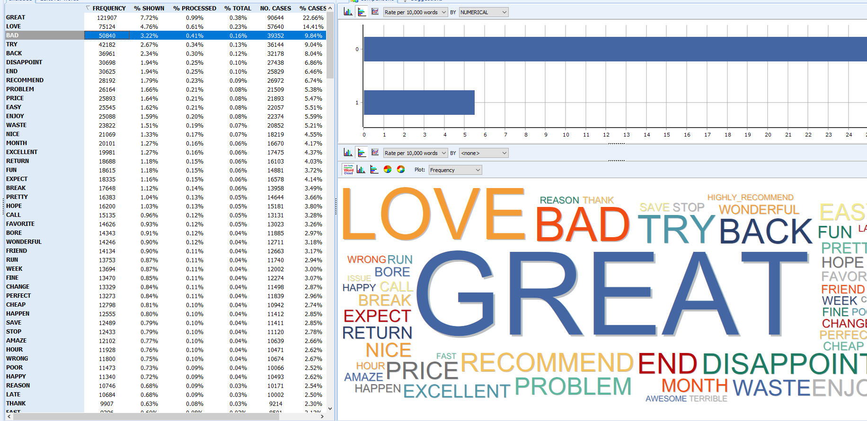
Example: The Word “Bad” Shows High Association With a Negative Evaluation

Slide 18
Our Sentiment and Customer Evaluation Prediction Models
Sentiment=f(W_{s}, X_{s})
Sentiment=# of significant positive words minus # of significant negative words for predicting product evaluation label as being either positive or negative.
W_{s}=Positive and Negative Key Words and Phrases significant for predicting evaluation label
X_{s}=Other Variables (e.g. gender, region, industry, etc) significant for predicting evaluation label.
Evaluation=Customer’s scaled scoring of the product, the label being either positive or negative.

Slide 19
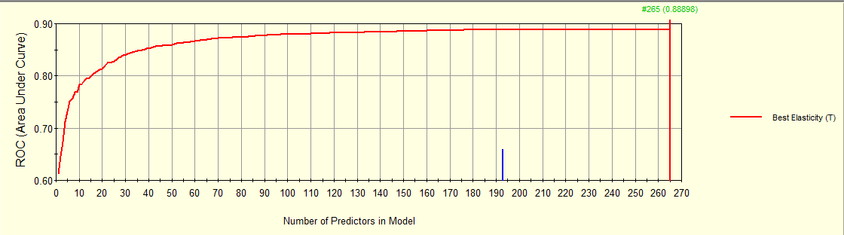
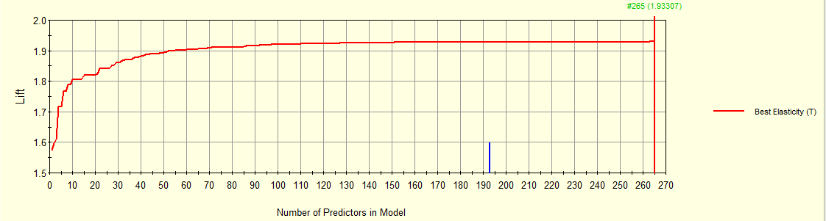
Predicting Customer Product Evaluation: Salford Systems Predictive Modeler (GPS) and Testing Shows Acceptable Information Gain Giving Confidence in Our Deployment and Usage
193 is a suggested number of predictor words

Slide 20
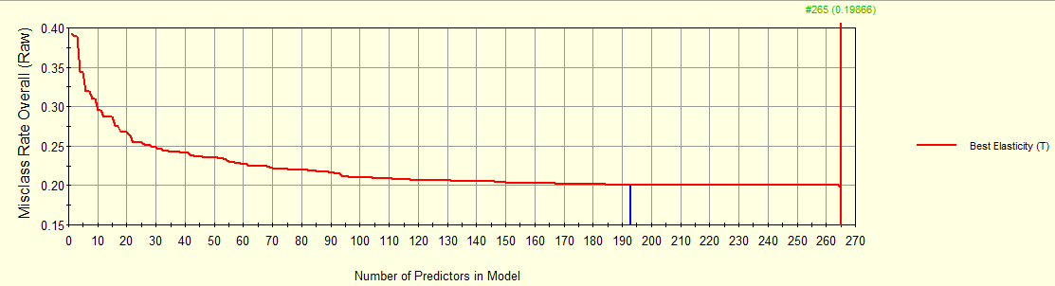
Using Predictive Modeling and Testing of Misclassification Rates Shows Acceptable Information Gain Giving Confidence in Our Deployment and Usage

Slide 21
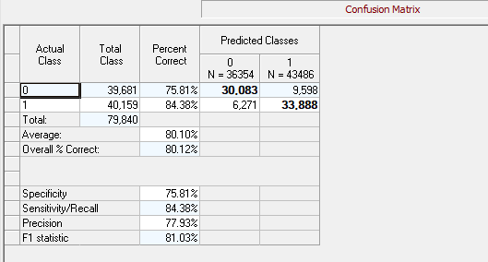
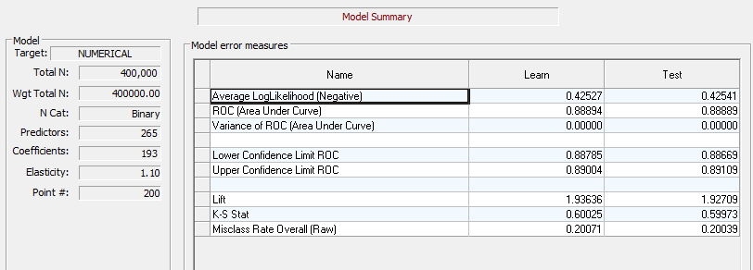
The Salford GPS Regularized Model Shows Acceptable Prediction Performance of the Binary Classification of Customer Evaluation—Positive Vs Negative

Slide 22
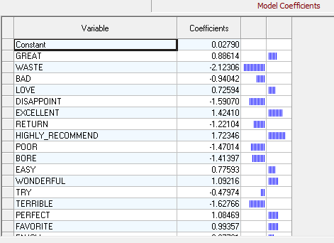
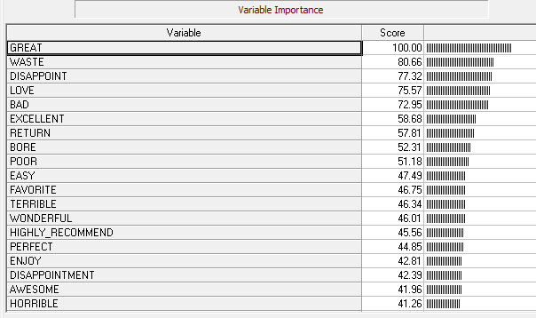
Predicting Evaluation: Identifying Key Words and Phrases by Importance and Sign—Salford Systems . The Significant Key Words are Used for Building the Sentiment Index

Slide 23
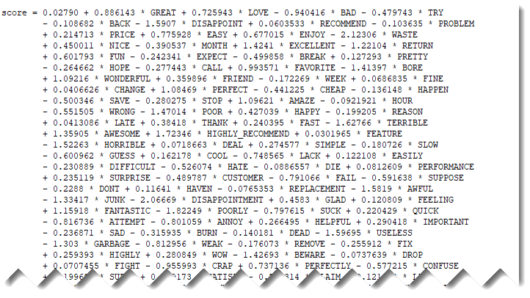
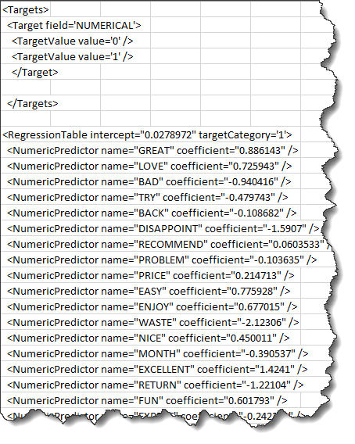
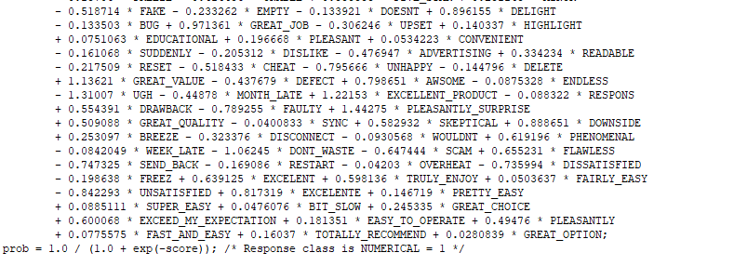
Regularized GPS Regression Model for Classifier Deployment with 193 Predictors—Salford Systems

Slide 24
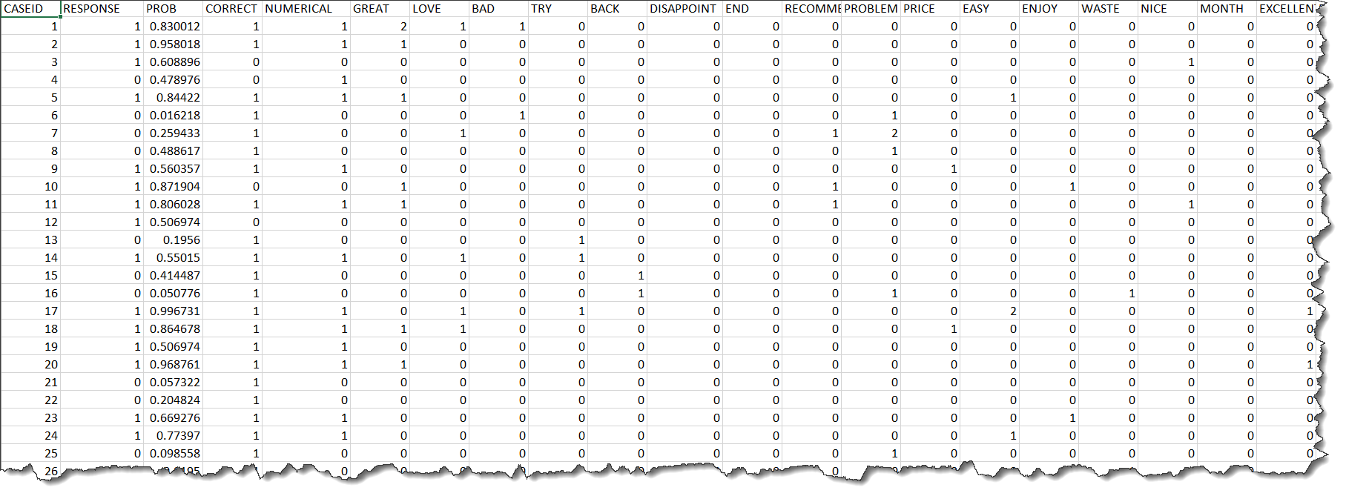
Record #1 Actual
Keyword Frequency Inputs to Model that help select variables to build a sentiment index of key positive and negative words
Record #1 Prediction
Classifier Predictions:1=Positive; 0= Negative

Slide 25
Now We Can Apply the Classifier to a different dataset on a daily basis. This dataset consists of product discussions in an industry. We use Wordstat combined with Minitab’s CUSUM control chart for the display of process shift.
Here we Apply a Non Amazon, Text Dataset of Customer Interactions and Convert To a Time Series
Plotting Sentiment as # of Positive Words minus number of negative words
New Release of Product Created Positive Sentiment
This helps the business understand the impact of events upon customer sentiment and behavior.

Slide 26
Part 2—Identifying the Underlying Causes of Sentiment—Converting Text Variables Into Strategy and Action
Example –Comcast Dataset

Slide 27
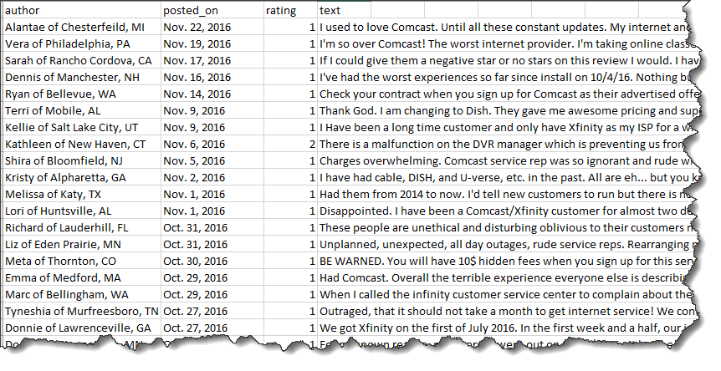
Comcast VOC Public Dataset
Available data of Comcast complaints 5600+ reduced to 4100 after remove missing and uncertain values
It consists of the following fields:
Author (first name, city and state)
Posted_on date
Rating (0 to 5)
Complaint text

Slide 28

Sifting for Gold

Slide 29
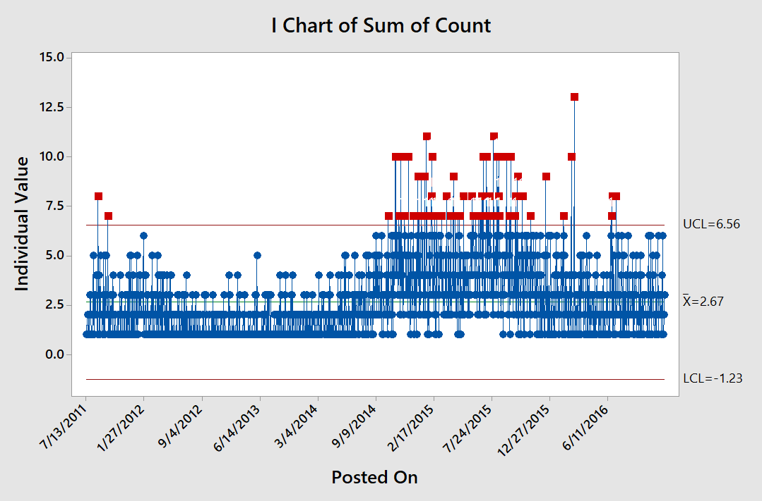
Minitab Graph:
Number of Complaint
Records Posted
Per Day in
Comcast
Dataset Grew
Throughout 2015
Period of Difficulty for the Company

Slide 30
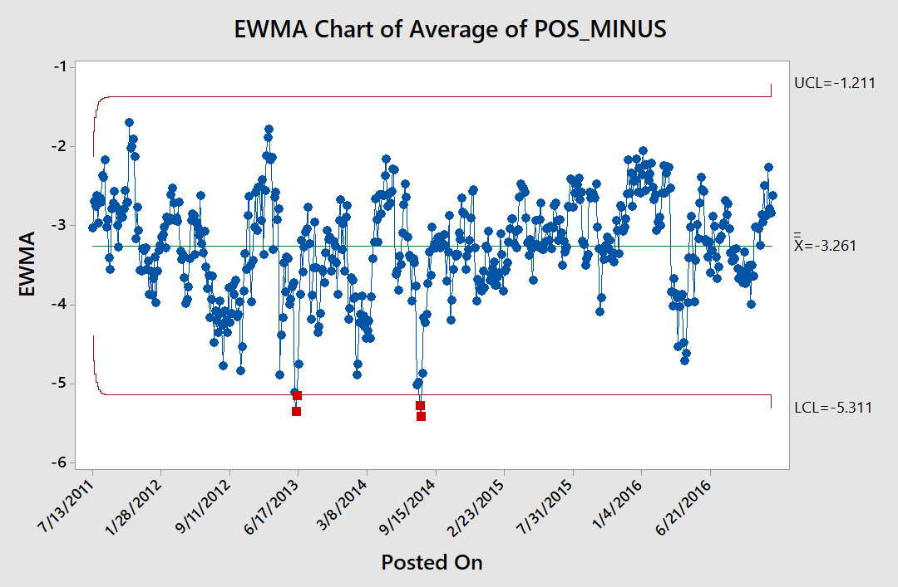
….Average Sentiment Did Not Shift However

Slide 31
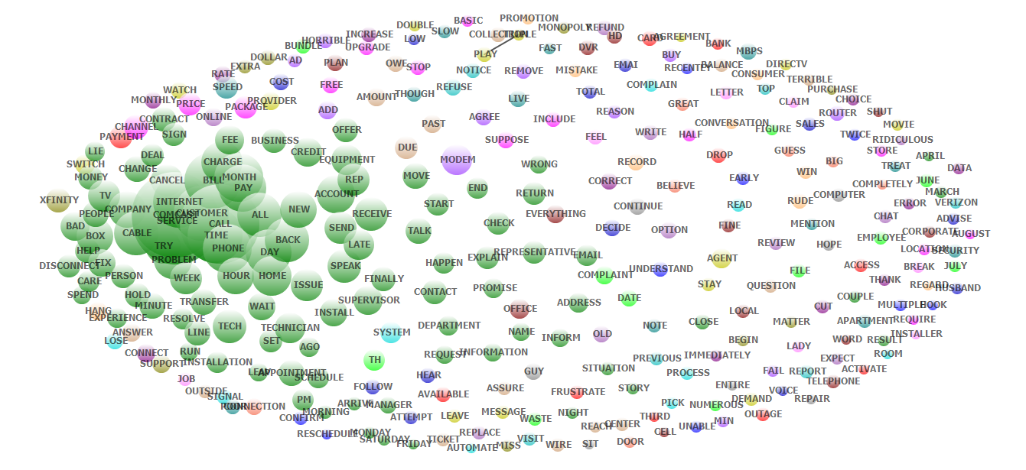
Wordstat Text Analysis Applied to Comcast Dataset
Layer #1 Overall Bag of Words and Topics –Informative But Not Yet Actionable

Slide 32
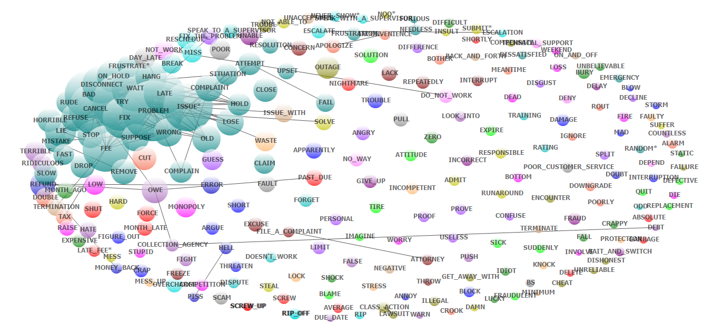
Wordstat Text Analysis Applied to Comcast Dataset —With Negative Dictionary Filter
Layer #2 Topics –Much More Revealing and More Actionable

Slide 33
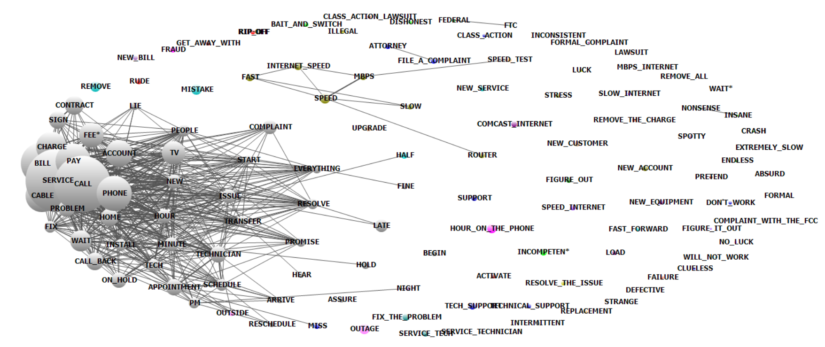
Layer #3 Topics Custom Dictionary –Much More Revealing and More Actionable

Slide 34
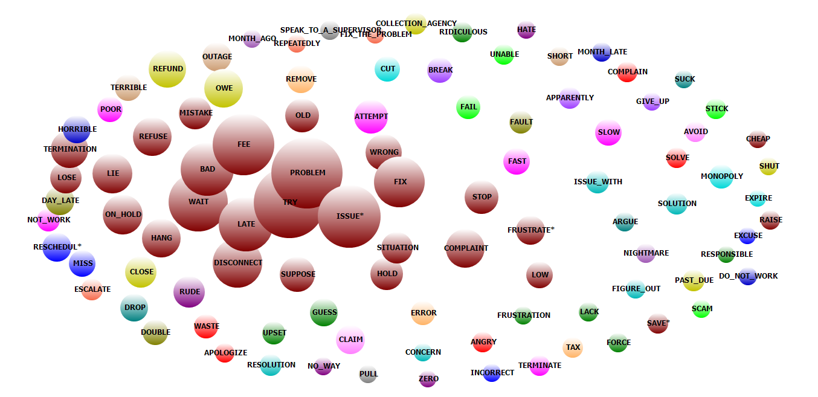
Filtered For Those Who Mentioned Cancellation (Churn)

Slide 35
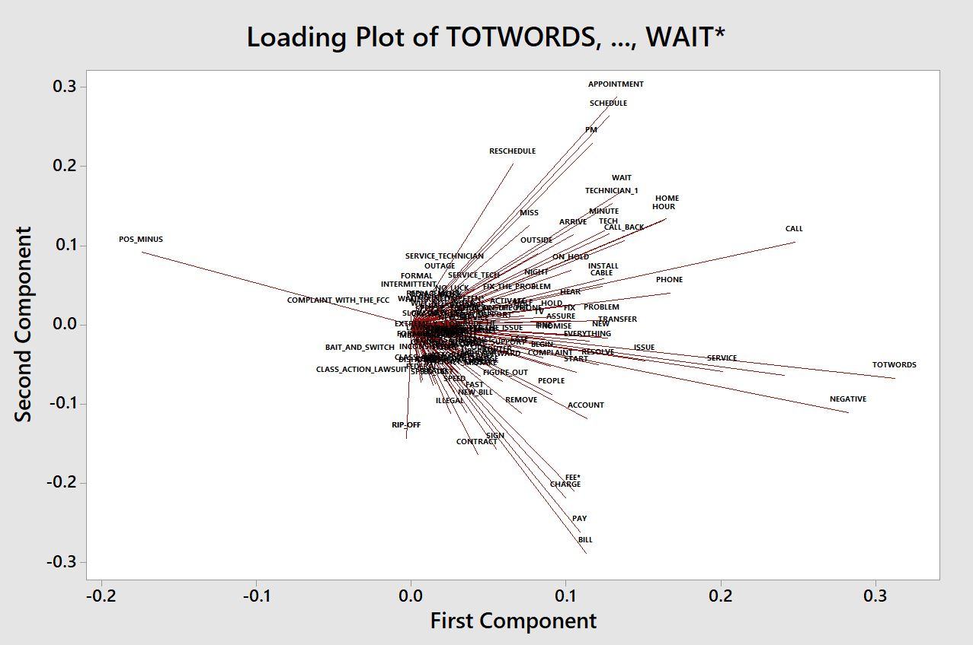

Slide 36
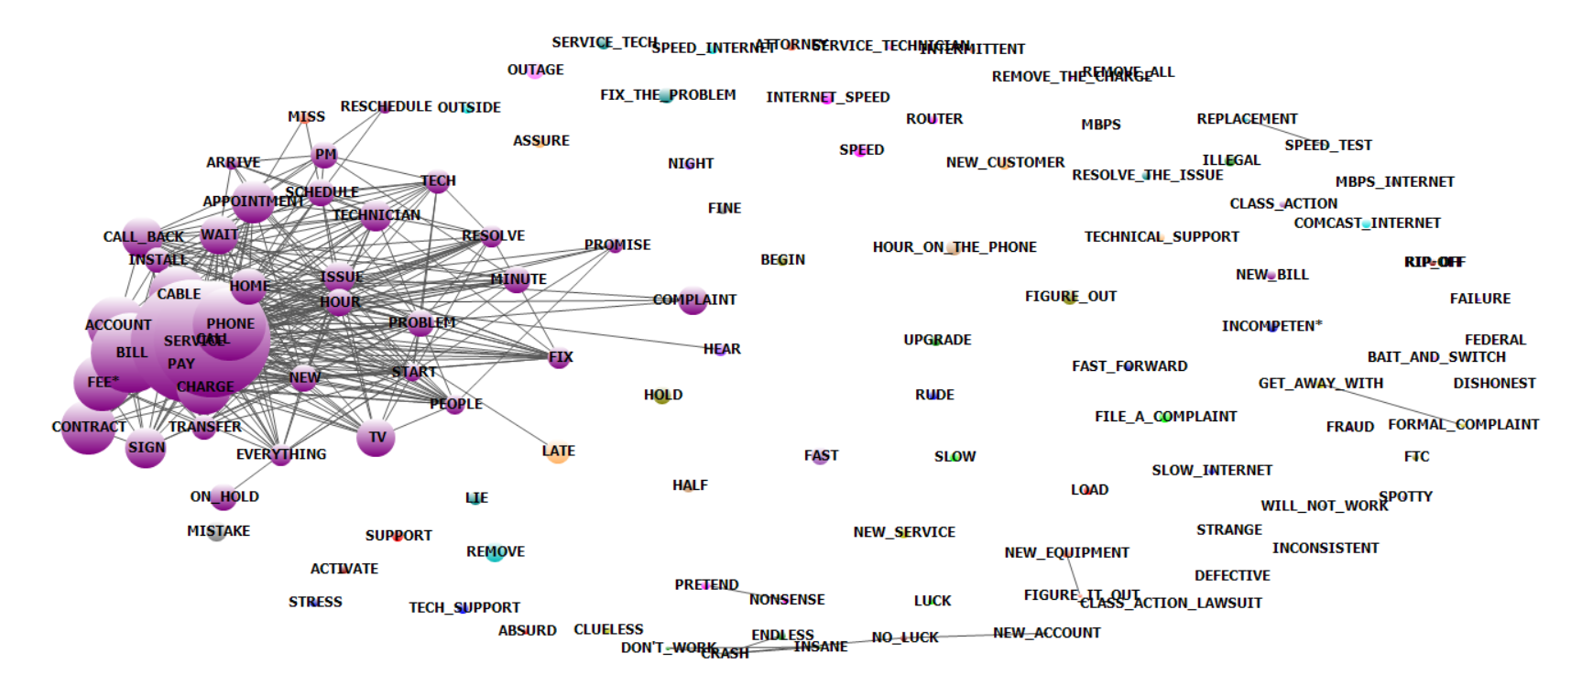
Analysis of Customers Predicted to Churn with P≥ 0.5
Sentiment Increases the Strength of the Model
Clearly the technician’s visit, the inability to resolve and the contract/billing drive the model.

Slide 37
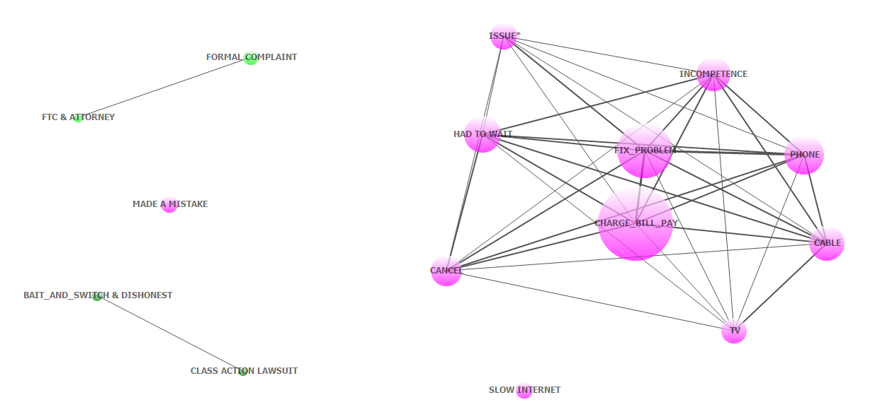
Wordstat Text Analysis Applied to Comcast Dataset—With Factor Analysis Dictionary Filter
Summarizing Layer #3—Topics and Phrases with Linkages Form Actionable Clusters
Result: The Underlying Problem was Comcast’s Inability to Resolve Emergent Phone, Cable, TV Performance Problems. These problems translated to customer billing issues that were compounded by poor customer service practices. These were the priorities for Comcast at the time. Did they have early visibility to this?

Slide 38
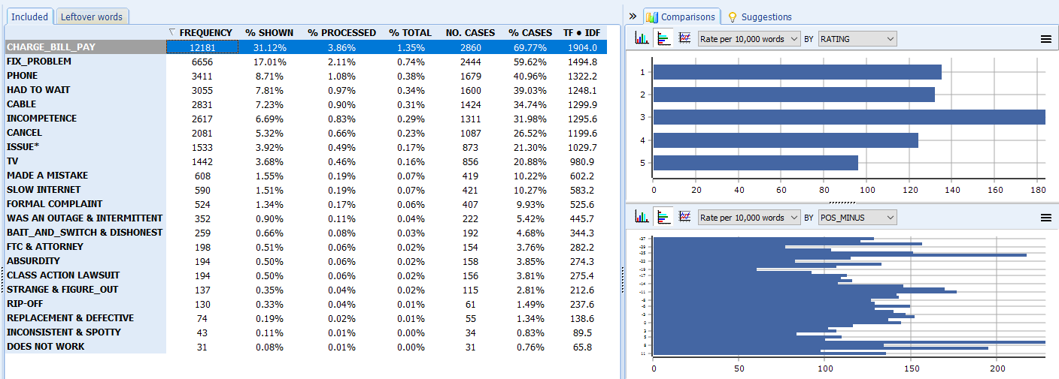
Bag of Words—Dataset Reduced By Factor Analysis, Dictionary, Key Word in Context and Other Cooccurrence Tools within Wordstat

Slide 39
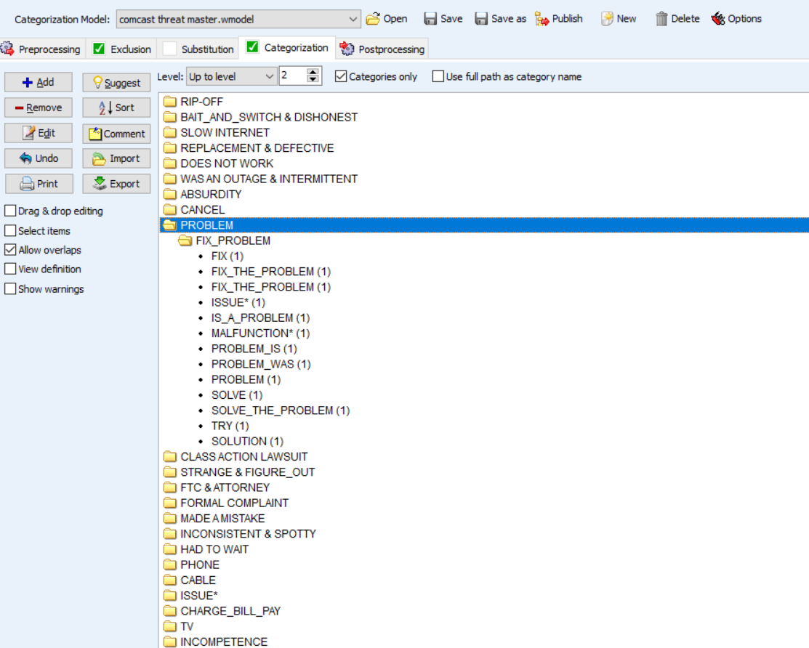
Building the Custom Dictionary helps identify actionable topics, phrases and words

Slide 40
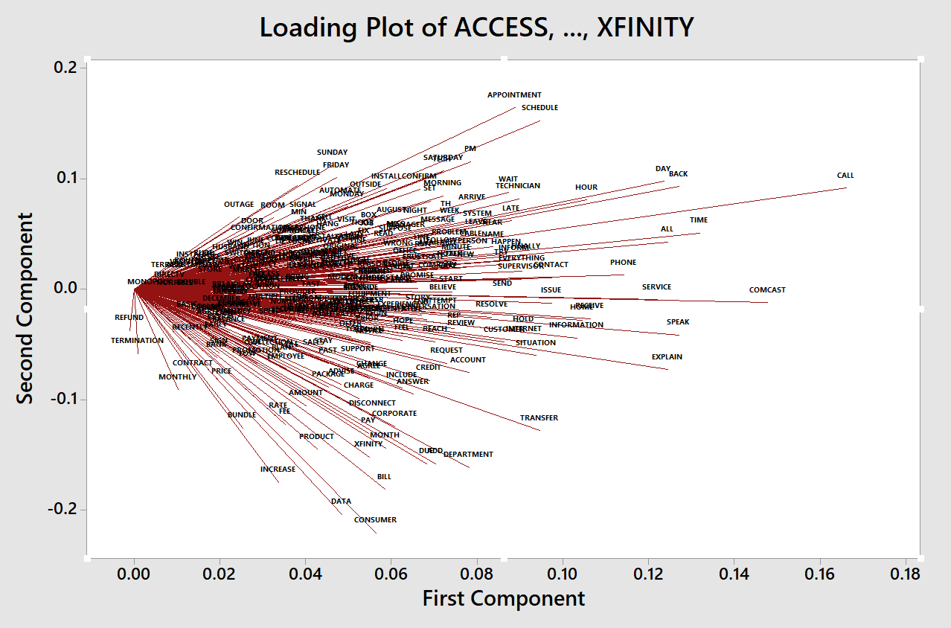
Filtered For Those Who Mentioned Cancellation (Churn)
Scheduling Problems with Service Technician, Waiting, Could Not Fix Problem
These are Technical Problems and Business Process Problems.
Triggering a Technical Task Force and Six Sigma
Called Customer Service But Had Difficulty Requiring Escalation and Wasting Time
Unsuccessful Dispute Resolution Regarding Fees

Slide 41
Minitab Graph:
Number of Complaint
Records Posted
Per Day in
Comcast
Dataset Grew
Throughout 2015
In retrospect the value add of the sentiment model to Comcast would have been to make the emergent problems visible earlier with clarity to the underlying causes of the problems. Perhaps this would have reduced the duration of the trouble period.

Slide 42
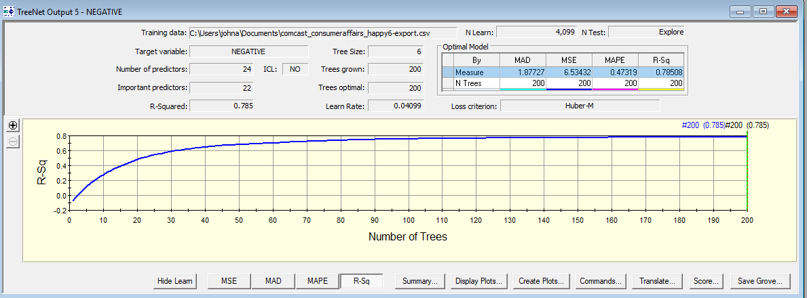
Machine Learning Prediction Performance of Negative Sentiment (Negative Word Count)
Based Upon Layer #3 Predictors Exploratory-Validation Not Applied

Slide 43
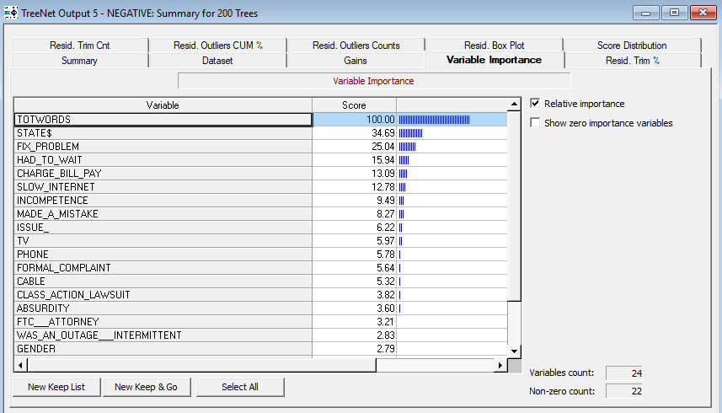
Predicting Negative Sentiment (Negative Word Count) Reveals the Relative Importance of Predictors
Predictive Modeling Makes the Priorities Visible

Slide 44
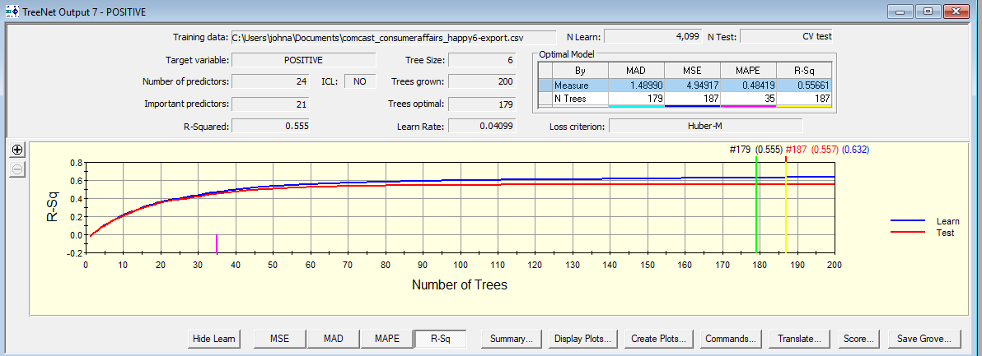
Predicting Negative Sentiment (defined as Negative Word Count)-With K-Fold Validation

Slide 45
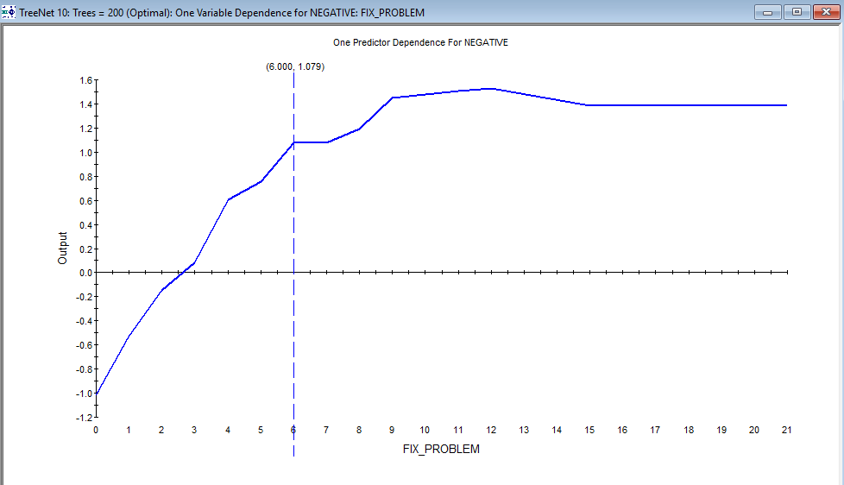
How Not Fixing the Problem Drove Negative Sentiment
# Mentions of needing problem fixed

Slide 46
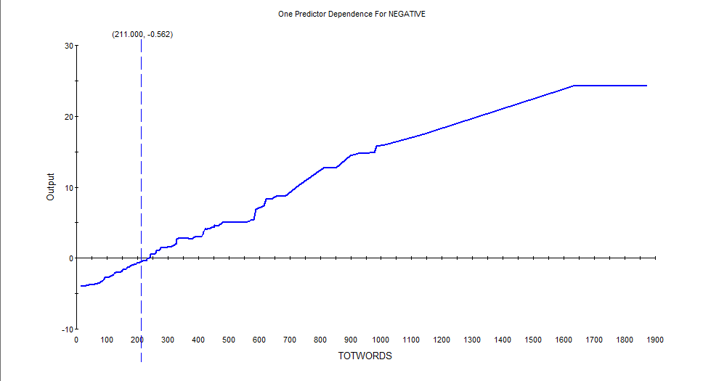
As We Will See When Predicting Churn --The Number of Words in a Record Signifies Strong Negative Feelings by Consumers

Slide 47
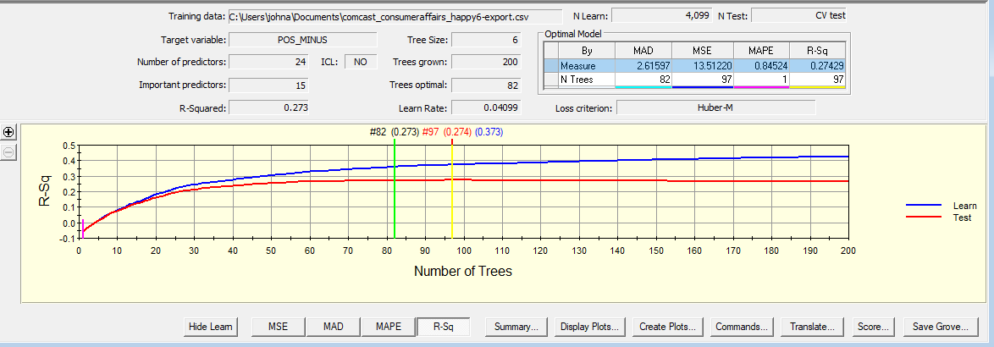
Predicting Net Sentiment-Exploratory With K-Fold Evaluation
in the Comcast Example

Slide 48
Part 3—Predicting Customer Churn Given Sentiment Plus Other Measures
Example –Comcast Dataset

Slide 49
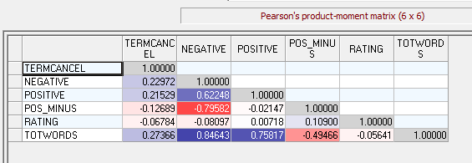
Correlation Coefficients Showing Associations of Sentiment Measures with Churn (Terminate/Cancel)
Churn Proxy
Alternative Sentiment Measures
Revealing Discovery
Total Words and Negative Words are Highly Associated. For the Comcast Example the Sentiment Measures Proved More Effective Than the “Rating” Measure.

Slide 50
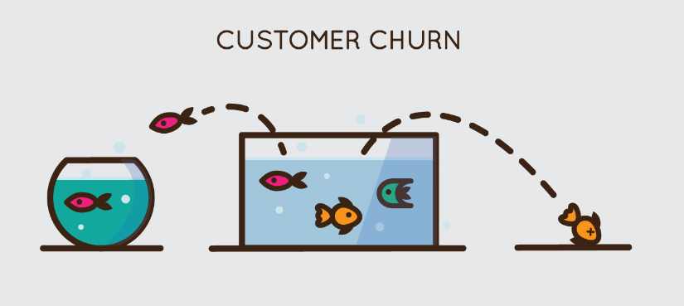
Customer Churn: When a Customer Ceases His or Her Relationship with a Company.
Identification, Risk Measurement, Risk Mitigation
Comcast Example

Slide 51
Our Updated Prediction Model
Churn=g(W_{c}, X_{c}, S)
W_{c}=Key Words and Phrases significant for predicting churn
X_{c}=Other Variables (e.g. gender, region, industry, etc) significant for predicting churn
S=Sentiment=f(W_{s},X_{s})
Hence, Churn=g(W_{c}, X_{c}, S (W_{s},X_{s}))
Which gives us two sets of variables for consideration. The analysis is a two stage problem. Requiring very robust tools…

Slide 52
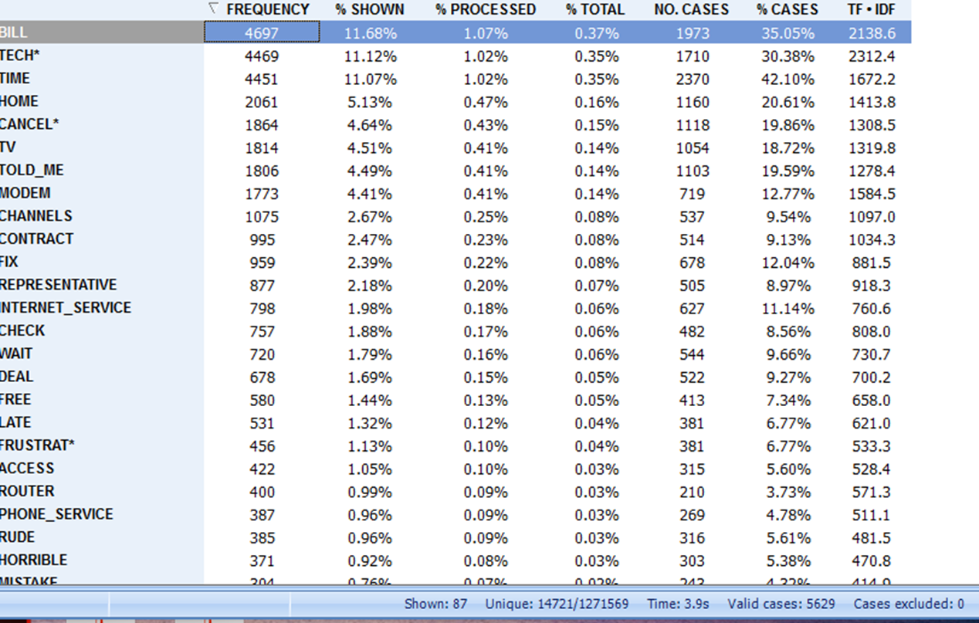
Text Analytics Breaks Statements Down To Bag of Words
The Word “Cancel” and Its Variants are Identified as Interesting Proxy Labels for Possible Prediction of Churn

Slide 53
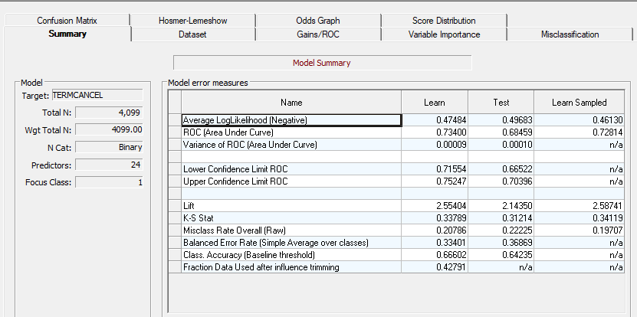
Salford Systems Treenet ---Predicting Churn with K-Fold Validation

Slide 54
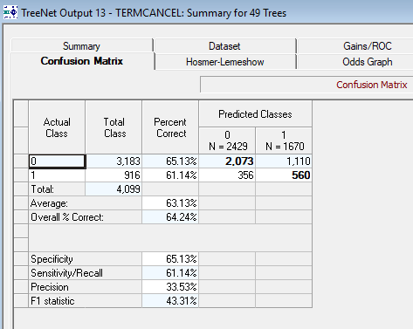

Slide 55
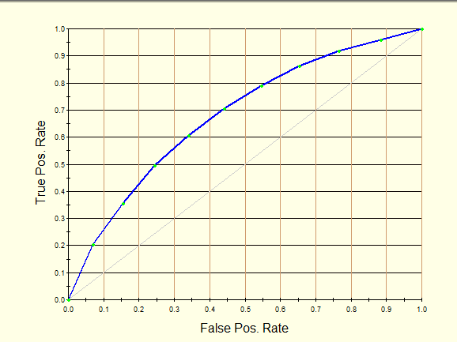
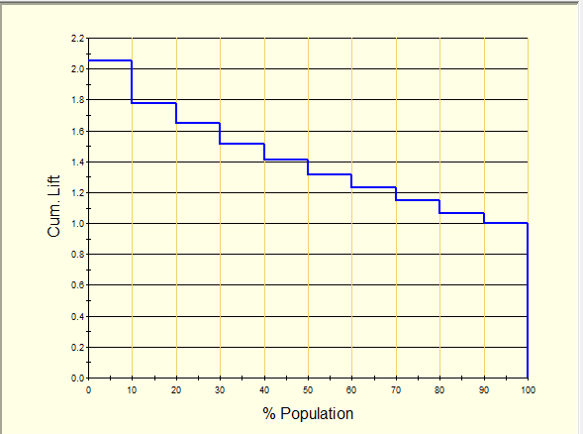
ROC Curve Shows Value From the Model
Lift Curve Shows Value From the Model
Information Gain Exists

Slide 56
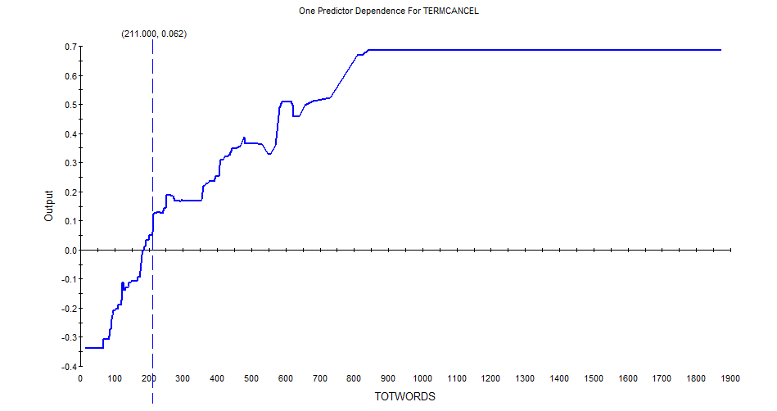
Total Words in a Record Captures Emotion Which Becomes a Useful Predictor of Churn

Slide 57

The Effect of Churn Predictor Variables Can be Non Linear

Slide 58

The Non Linear Effect of Sentiment Upon Churn is Also Non Linear
Sentiment

Slide 59

The Non Linear Effect of Sentiment Upon Churn is Also Non Linear
Sentiment

Slide 60

Full Dataset Analysis of Those not Mentioning Cancel

Slide 61

Those Who Did Not Mentioned Cancel

Slide 62

Full Dataset Analysis of Those Mentioning Cancel

Slide 63

Those Who Did Mention Cancel

Slide 64

Those Who Said They Would Cancel and Have Negative Sentiment

Slide 65

Net Pos less than -10

Slide 66


Slide 67

Analysis of Complaints in Critical Period 10/01/2014 Through 07/01/2016

Slide 68

Those who Mentioned Cancel Analysis of Complaints in Critical Period 10/01/2014 Through 07/01/2016

Slide 69





Slide 70


Slide 71





Slide 72
Part 4—Forecasting Time Series of Sentiment
Using Machine Learning with Images

Slide 73
So Far We Have Discussed the Derivation of Sentiment and Have Observed Its Predictive Applications.
Our Next Question Addresses the Forecasting of Sentiment As a Time Series.
Traditional Time Series Assumes Autoregression where: S_{T+1} = f(Ф S_{T})
S_{T+1} refers to tomorrow’s value of sentiment
S_{T} refers to today’s value of sentiment
Ф is a coefficient (a weight value).
This can be an invalid assumption with sentiment because:
Sentiment is that is tied to yesterday’s information cannot predict turning points (changepoints) caused by today’s information.
This leads to a large prediction variance
Comcast Example…………………

Slide 74

Autocorrelation analysis suggests S_{T+1} ≠ f(Ф S_{T}) which invalidates traditional time series modeling of sentiment for the Comcast example

Slide 75

Time Series of Comcast Sentiment.
Forecasts default to the average and miss the valuable turning points.

